Slide 1

열정을 가진 자들이 모여 세상을 개척한다
심화반 Week 8.
Transformer
Presenter: Daehyun Kim
Kakao Tech. Google Developer Groups
MODULABS AI/SW Lab.

Slide 2
01
Transformer

Slide 3

PNP
PASSSION & PIONEER
Transformer
Transformer
트랜스포머 모델입니다.

Slide 4

PNP
PASSSION & PIONEER
Transformer
Transformer
이런 역할을 하죠

Slide 5

PNP
PASSSION & PIONEER
Transformer
Transformer
더 자세히보면
이렇게 되어 있습니다.
https://jalammar.github.io/illustrated-transformer/

Slide 6

PNP
PASSSION & PIONEER
Transformer
Transformer
더 자세히보면
이렇게 되어 있습니다.
https://jalammar.github.io/illustrated-transformer/

Slide 7

PNP
PASSSION & PIONEER
Transformer
Transformer
Encoder Decoder 내부 구조
https://jalammar.github.io/illustrated-transformer/

Slide 8
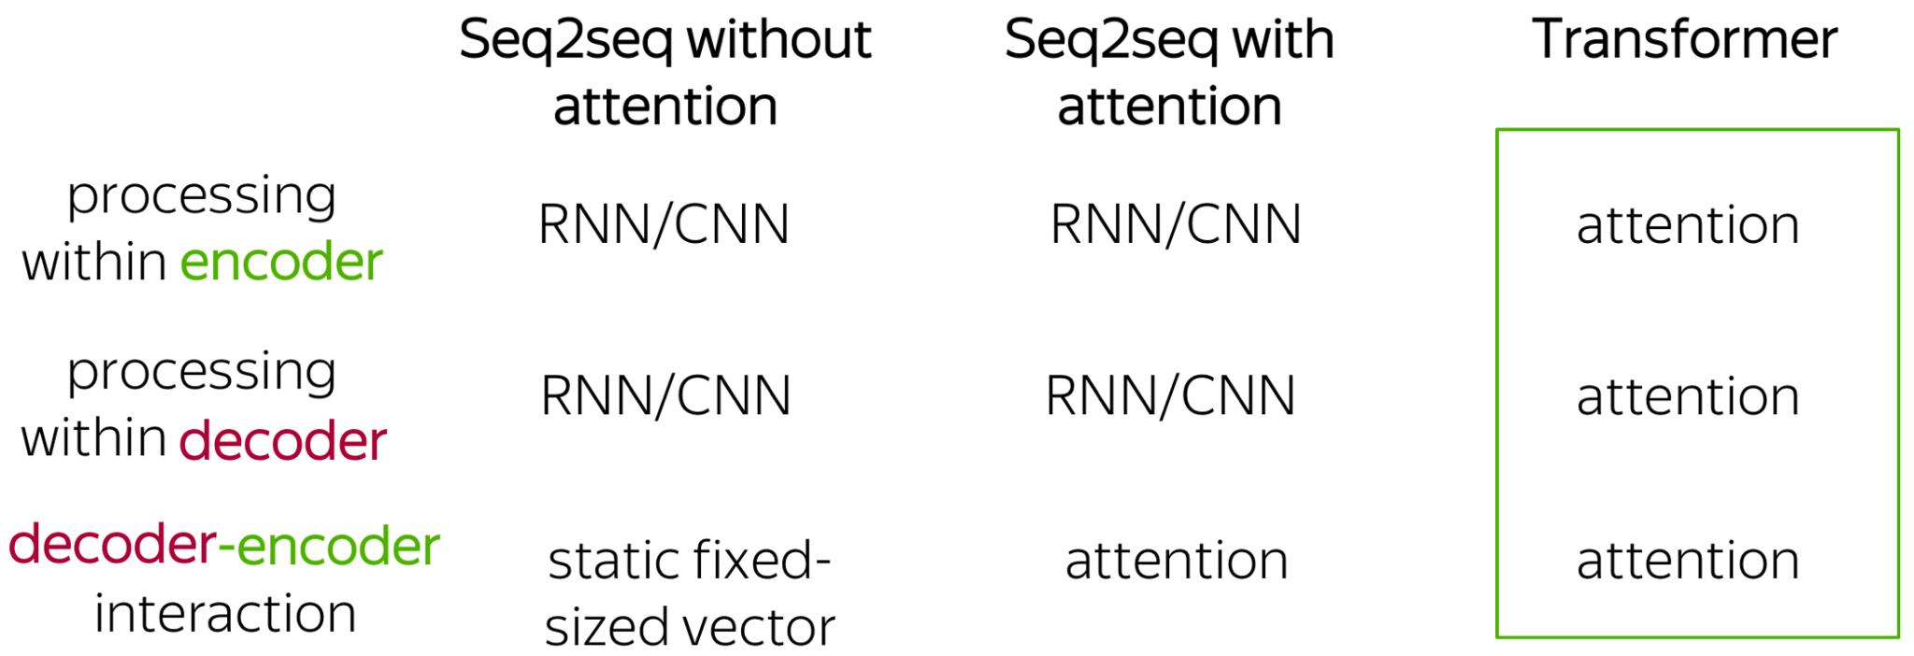
PNP
PASSSION & PIONEER
Transformer
Transformer
https://jalammar.github.io/illustrated-transformer/

Slide 9
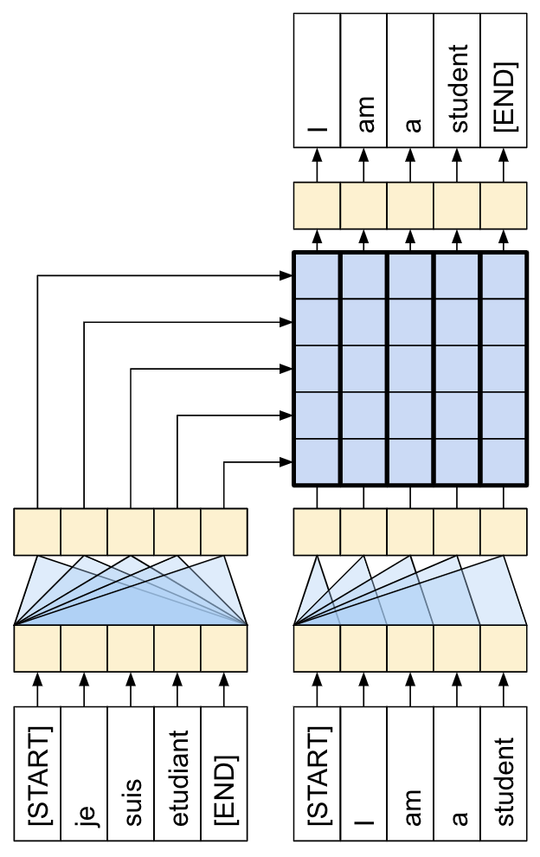
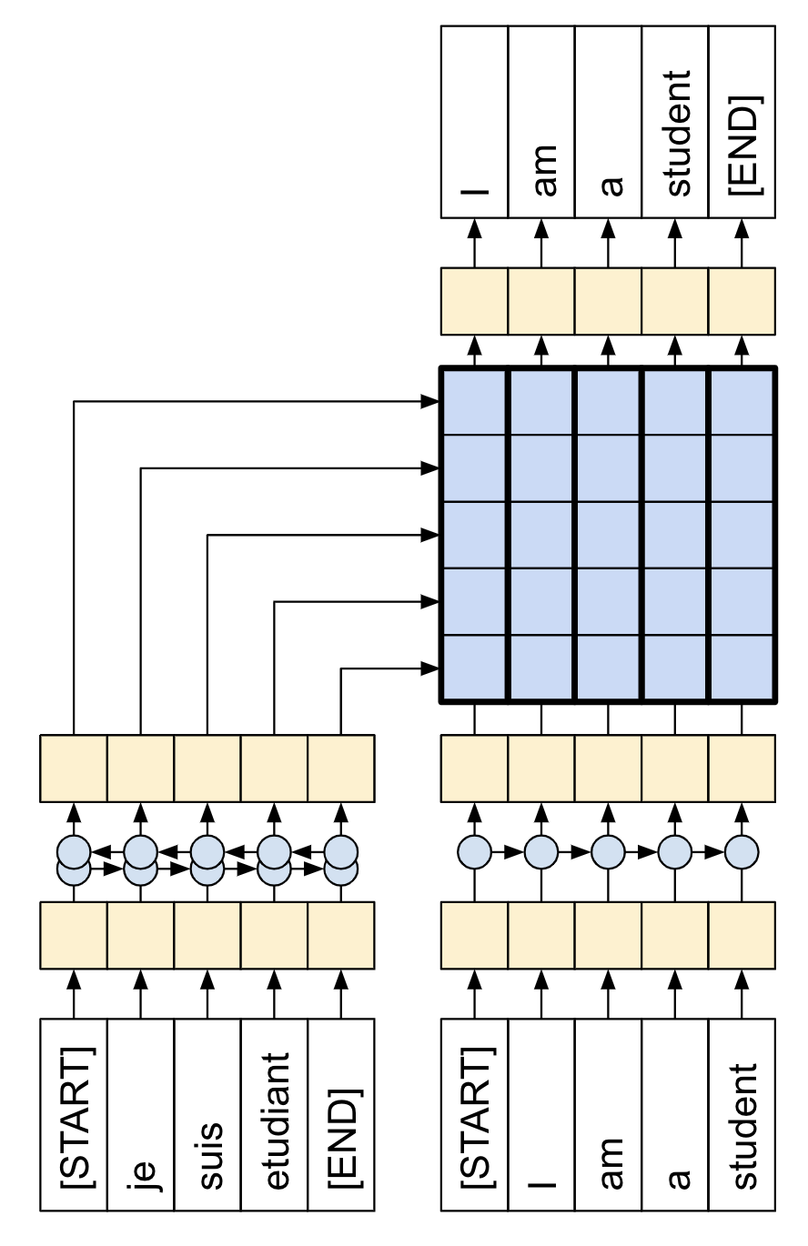
PNP
PASSSION & PIONEER
Transformer
Transformer
Seq2Seq VS Transformer
https://colab.research.google.com/github/tensorflow/text/blob/master/docs/tutorials/transformer.ipynb?hl=ko

Slide 10

PNP
PASSSION & PIONEER
Transformer
Transformer
https://lena-voita.github.io/nlp_course/seq2seq_and_attention.html

Slide 11
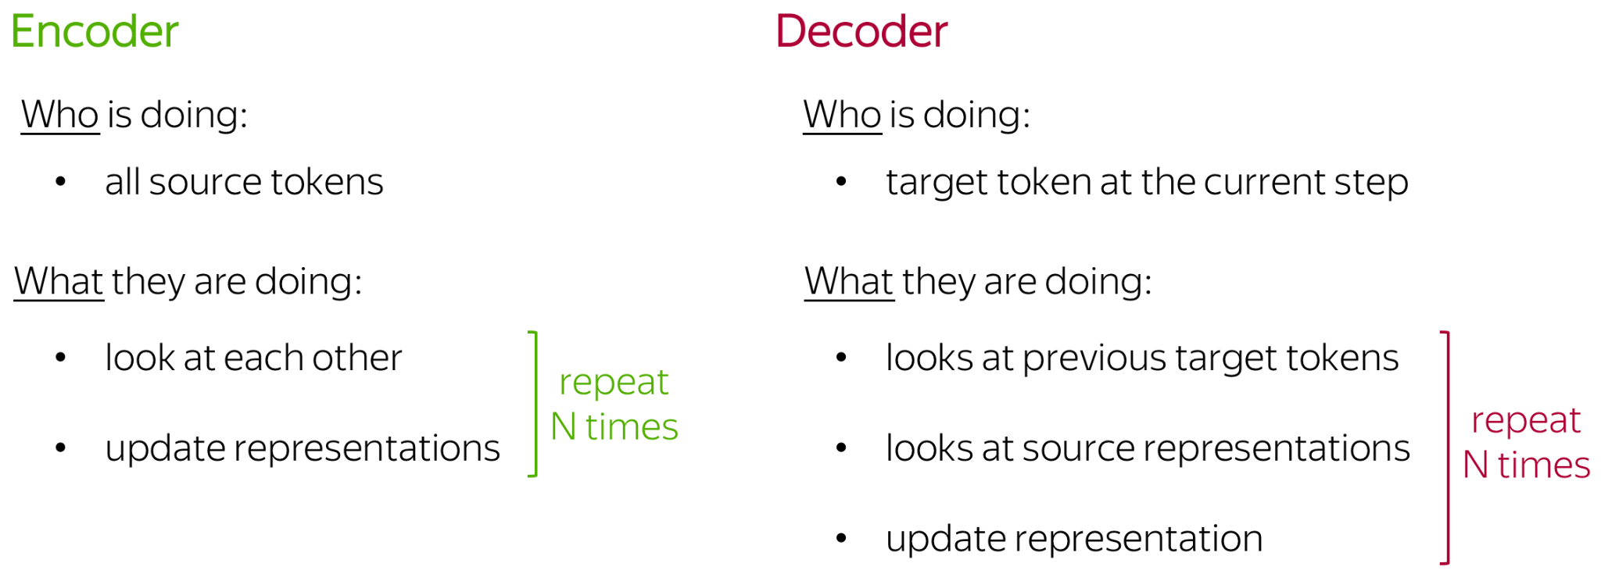
PNP
PASSSION & PIONEER
Transformer
Transformer
https://lena-voita.github.io/nlp_course/seq2seq_and_attention.html

Slide 12
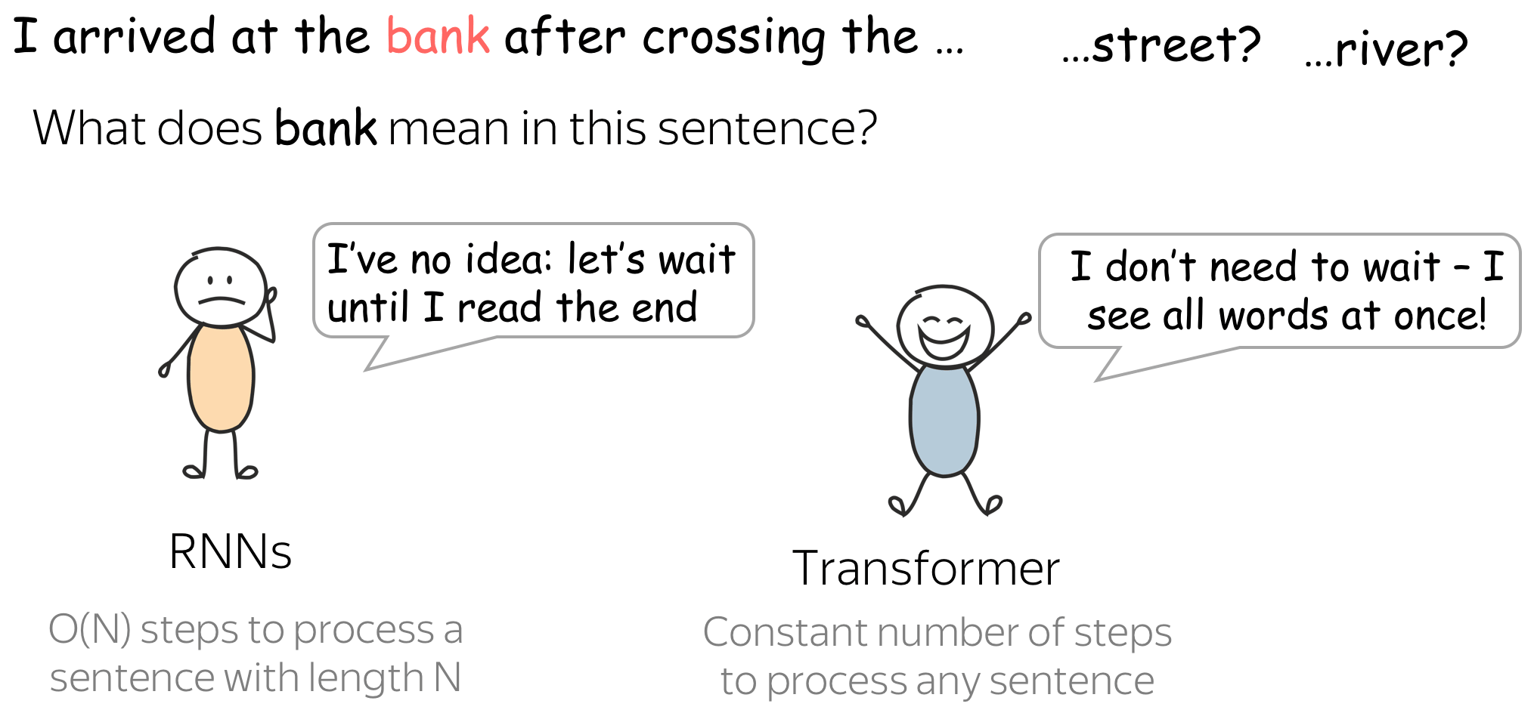
PNP
PASSSION & PIONEER
Transformer
Transformer
나는 은행에 도착 했어 … 거리를 건너서? 강을 건너서?
이 문장에서 은행이 의미하는게 뭐까요?
https://lena-voita.github.io/nlp_course/seq2seq_and_attention.html

Slide 13
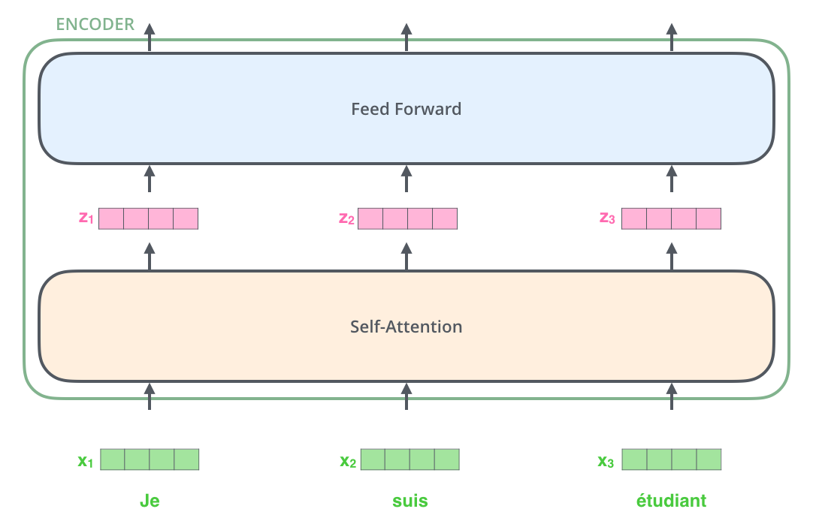
PNP
PASSSION & PIONEER
Transformer
Transformer
https://lena-voita.github.io/nlp_course/seq2seq_and_attention.html

Slide 14
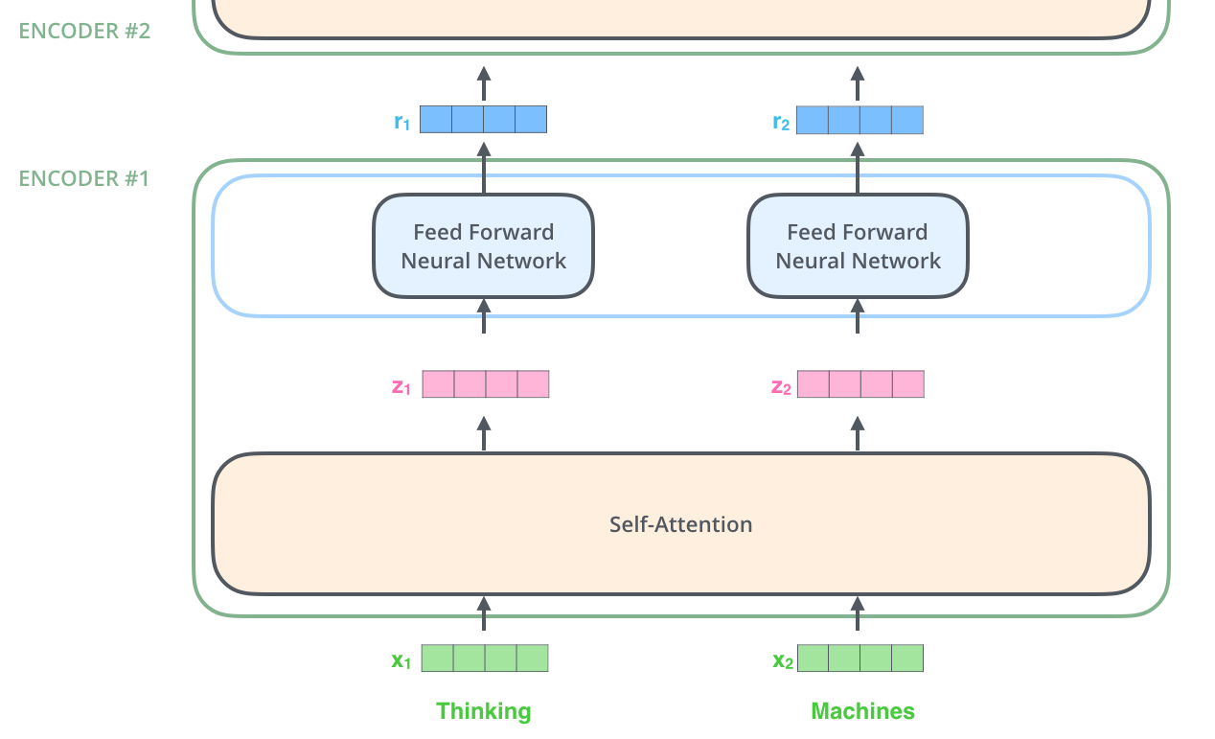
PNP
PASSSION & PIONEER
Transformer
Transformer
https://lena-voita.github.io/nlp_course/seq2seq_and_attention.html

Slide 15
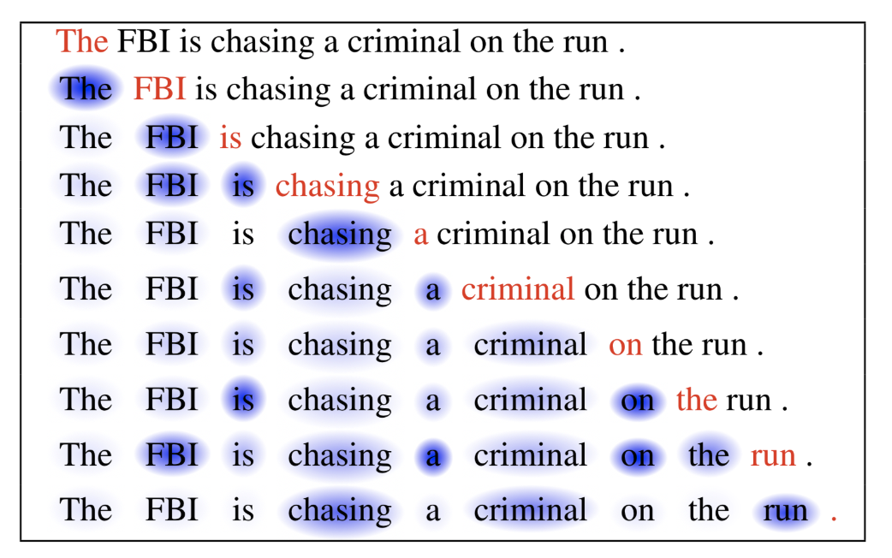
PNP
PASSSION & PIONEER
Transformer
Self-attention
NN을 이용해서 뭐가 중요한 단어인지 계산할 수 있을까?
https://lilianweng.github.io/posts/2018-06-24-attention/

Slide 16
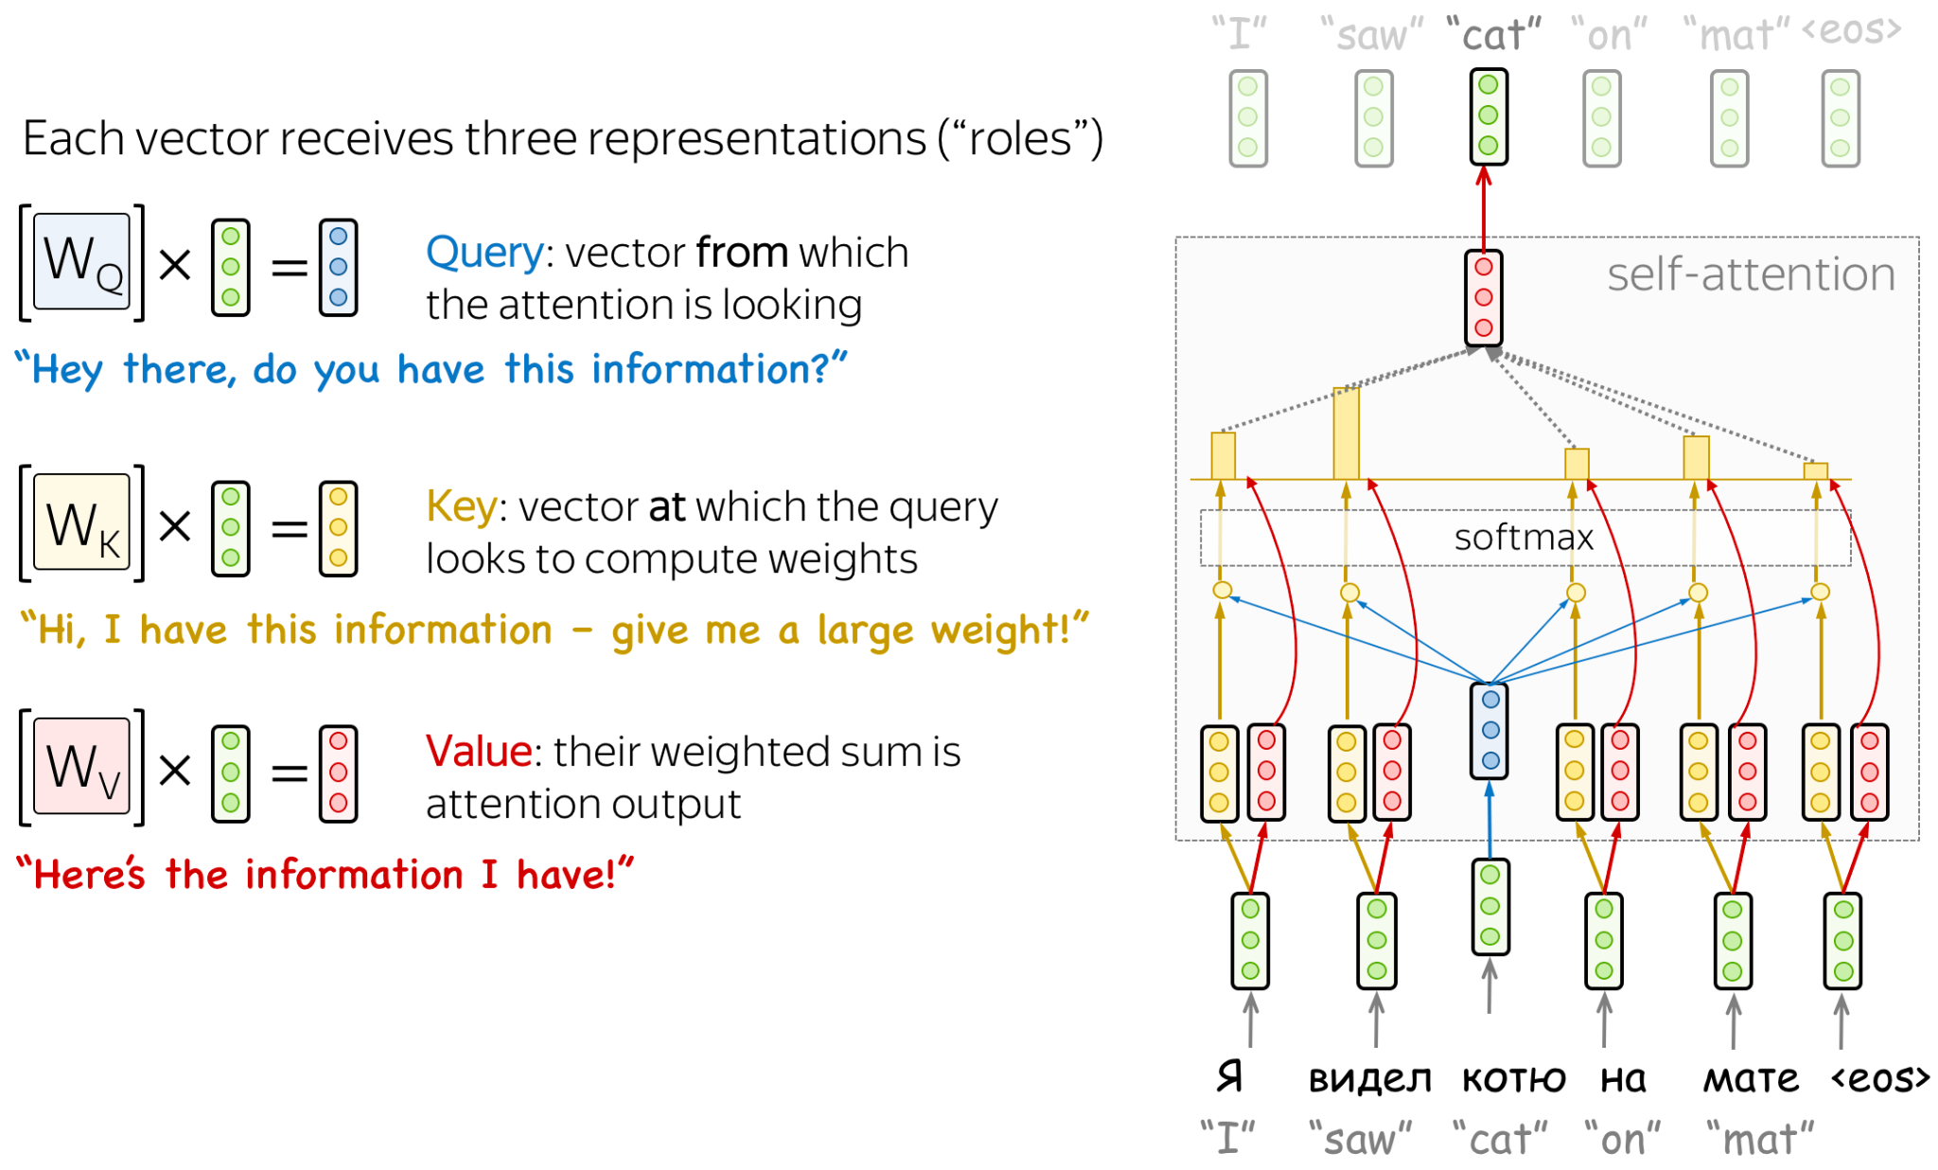
PNP
PASSSION & PIONEER
Transformer
Self-attention
https://lena-voita.github.io/nlp_course/seq2seq_and_attention.html

Slide 17
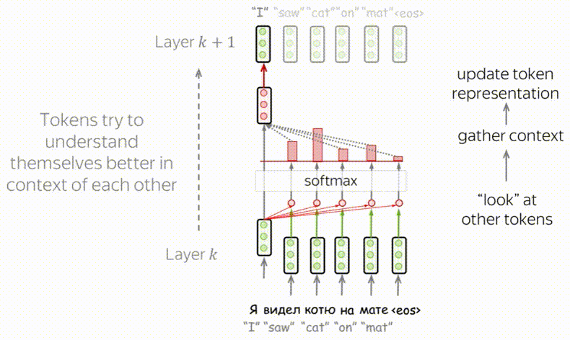
PNP
PASSSION & PIONEER
Transformer
Transformer
https://lena-voita.github.io/nlp_course/seq2seq_and_attention.html

Slide 18
PNP
PASSSION & PIONEER
Transformer
Self-attention
query
내가 찾고 정보를 요청하는 것 ( 유튜브 검색어 )
key
그 정보가 있는지 찾아보는 과정 ( 유튜브 영상의 제목 )
value
제공된 정보가 얼마나 가치 있는지 ( 유튜브 컨텐츠의 정확도 )
https://lena-voita.github.io/nlp_course/seq2seq_and_attention.html

Slide 19
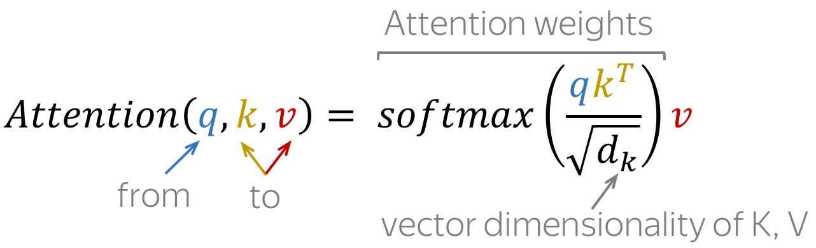
PNP
PASSSION & PIONEER
Transformer
Self-attention
https://lena-voita.github.io/nlp_course/seq2seq_and_attention.html

Slide 20
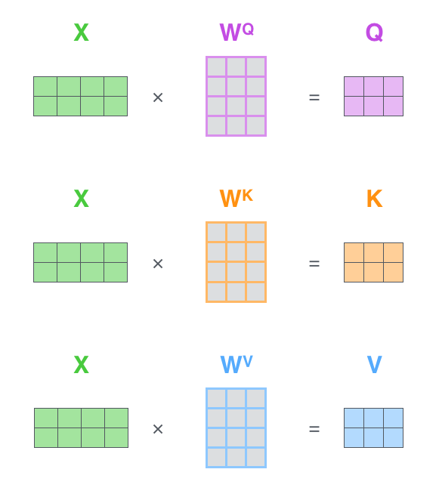

PNP
PASSSION & PIONEER
Transformer
Self-attention
일종의 Dense layer와 같은 가중치를 이용해 Q K V를 계산합니다.
https://jalammar.github.io/illustrated-transformer/

Slide 21
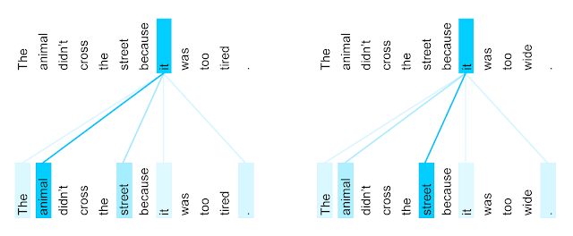
PNP
PASSSION & PIONEER
Transformer
Self-attention
같은 문장이라도 각 Head Attention 내부에선 다르게 동작
https://jalammar.github.io/illustrated-transformer/

Slide 22
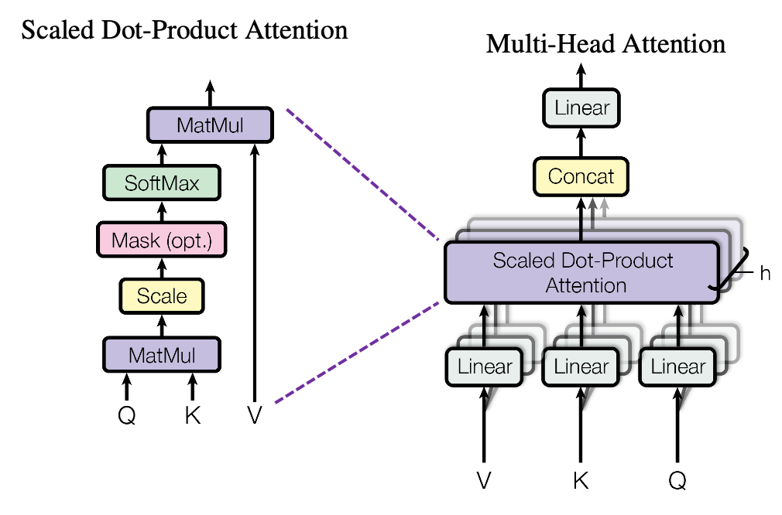
PNP
PASSSION & PIONEER
Transformer
Multi-Head Attention
https://lilianweng.github.io/posts/2018-06-24-attention/

Slide 23
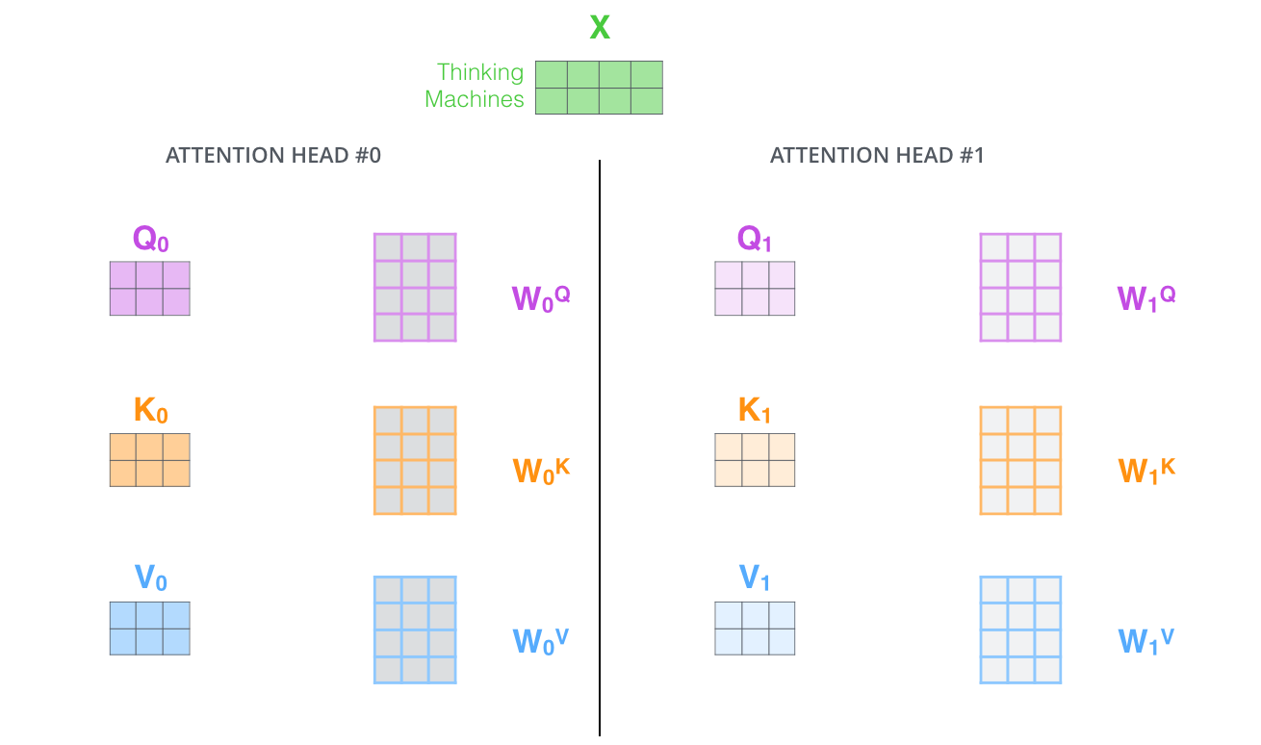
PNP
PASSSION & PIONEER
Transformer
Multi-Head Attention
여러개의 Attention Head를 가지고 있다.
https://lilianweng.github.io/posts/2018-06-24-attention/

Slide 24
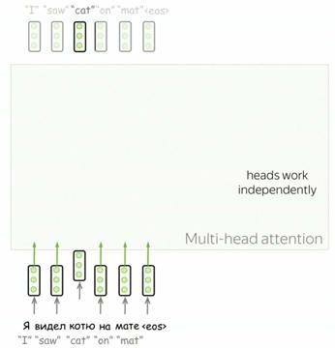
PNP
PASSSION & PIONEER
Transformer
Multi-Head Attention
https://lena-voita.github.io/nlp_course/seq2seq_and_attention.html

Slide 25
PNP
PASSSION & PIONEER
Transformer
Multi-Head Attention
https://lena-voita.github.io/nlp_course/seq2seq_and_attention.html

Slide 26
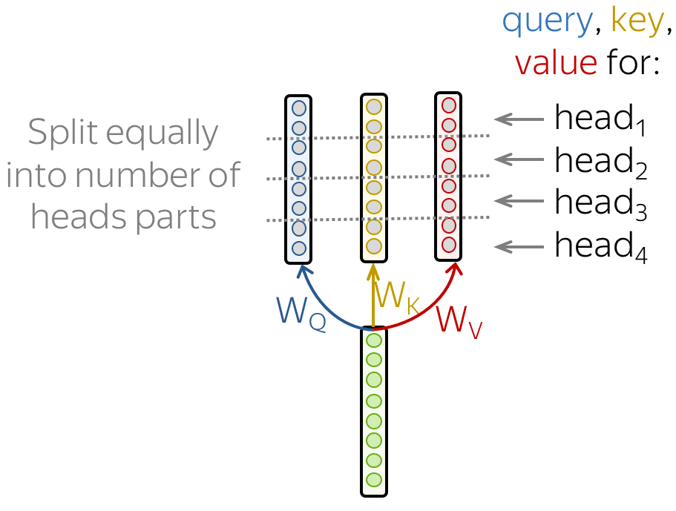
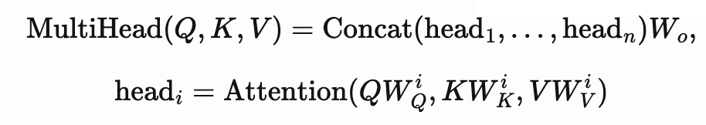
PNP
PASSSION & PIONEER
Transformer
Multi-Head Attention
각 Head Attention에서 나온 값을 연결해 사용합니다.
https://lena-voita.github.io/nlp_course/seq2seq_and_attention.html

Slide 27
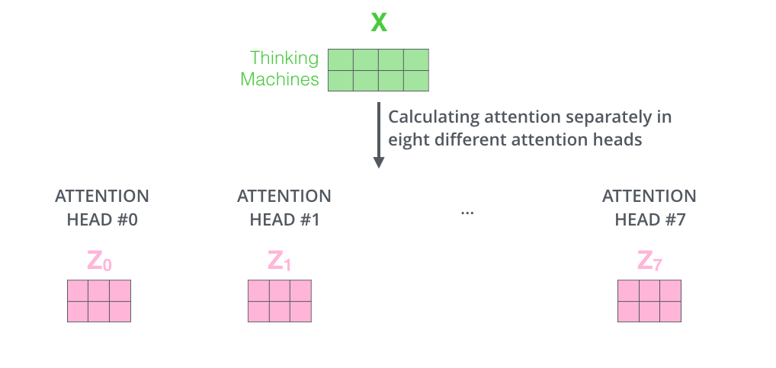
PNP
PASSSION & PIONEER
Transformer
Multi-Head Attention
하나의 토큰이 8개의 Attention Head로 변환되는 과정
https://jalammar.github.io/illustrated-transformer/

Slide 28
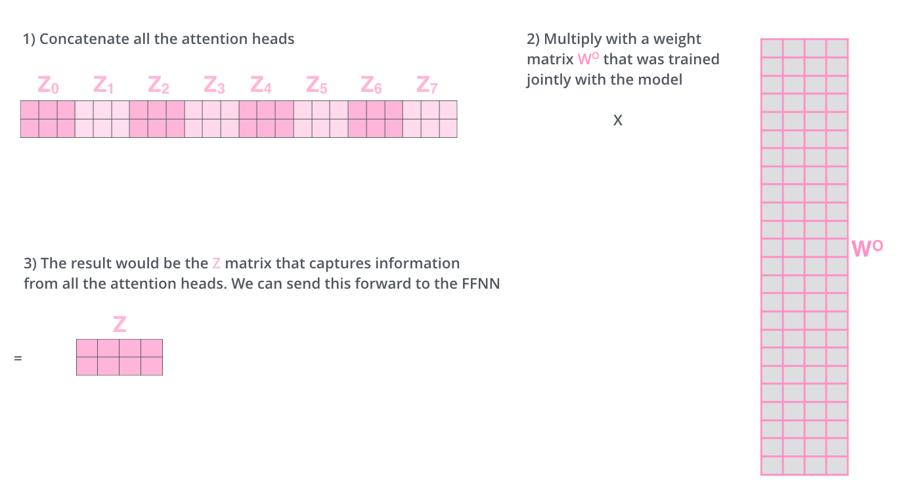
PNP
PASSSION & PIONEER
Transformer
Multi-Head Attention
이후 하나로 합쳐집니다.
https://jalammar.github.io/illustrated-transformer/

Slide 29

PNP
PASSSION & PIONEER
Transformer
Multi-Head Attention
이렇게 되면 하나의 토큰이라도 여러 개의 특성을 가지도록 계산 가능합니다.
https://jalammar.github.io/illustrated-transformer/
https://jalammar.github.io/illustrated-transformer/

Slide 30

PNP
PASSSION & PIONEER
Transformer
Transformer
https://lilianweng.github.io/posts/2023-01-27-the-transformer-family-v2/

Slide 31
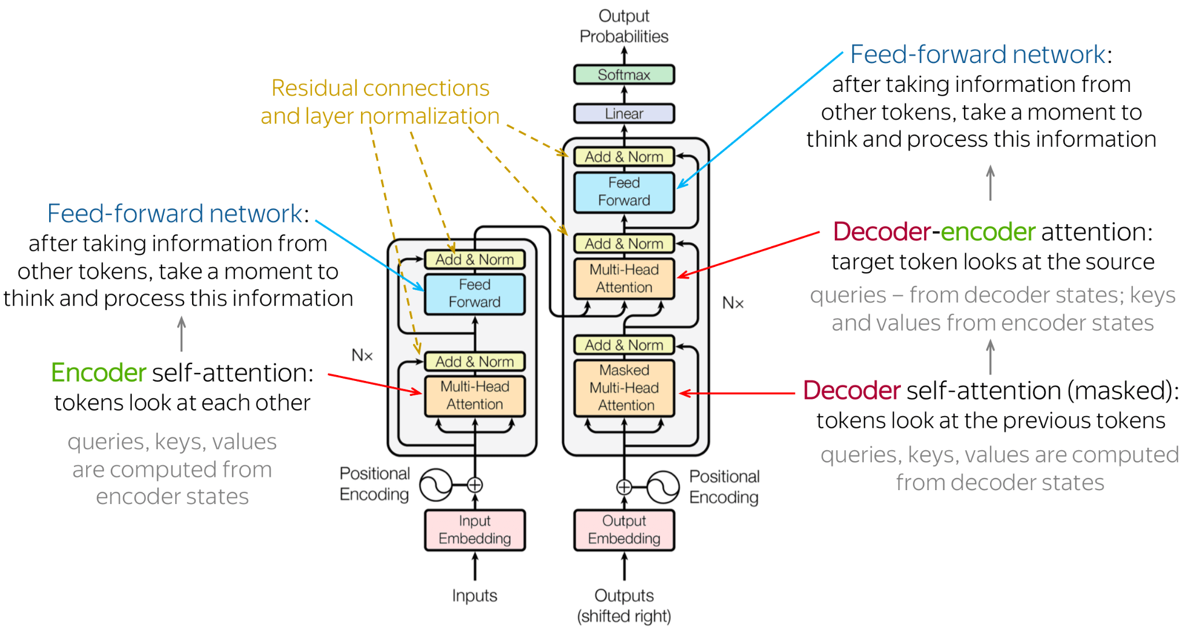
PNP
PASSSION & PIONEER
Transformer
Transformer
https://lilianweng.github.io/posts/2023-01-27-the-transformer-family-v2/

Slide 32
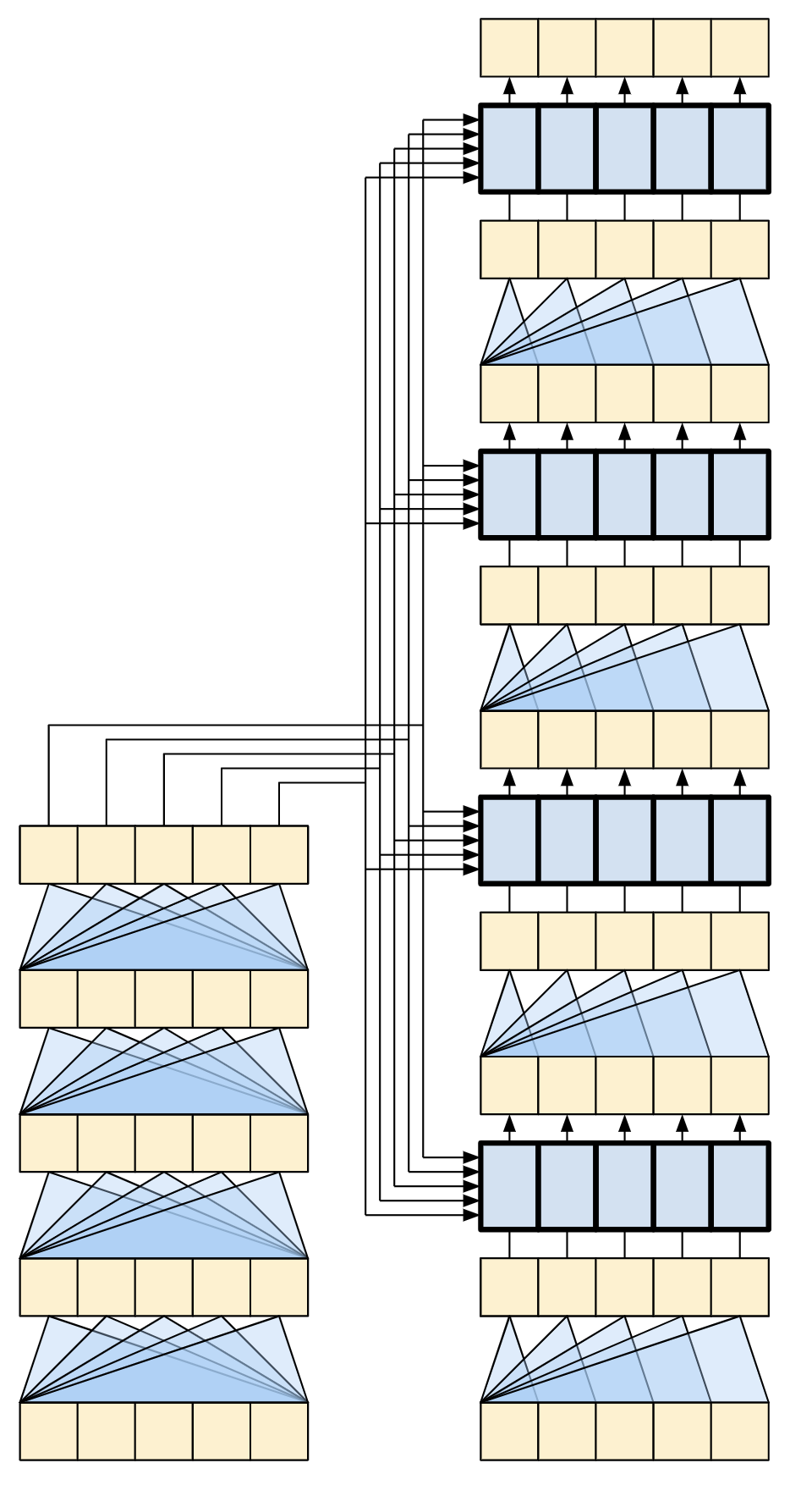
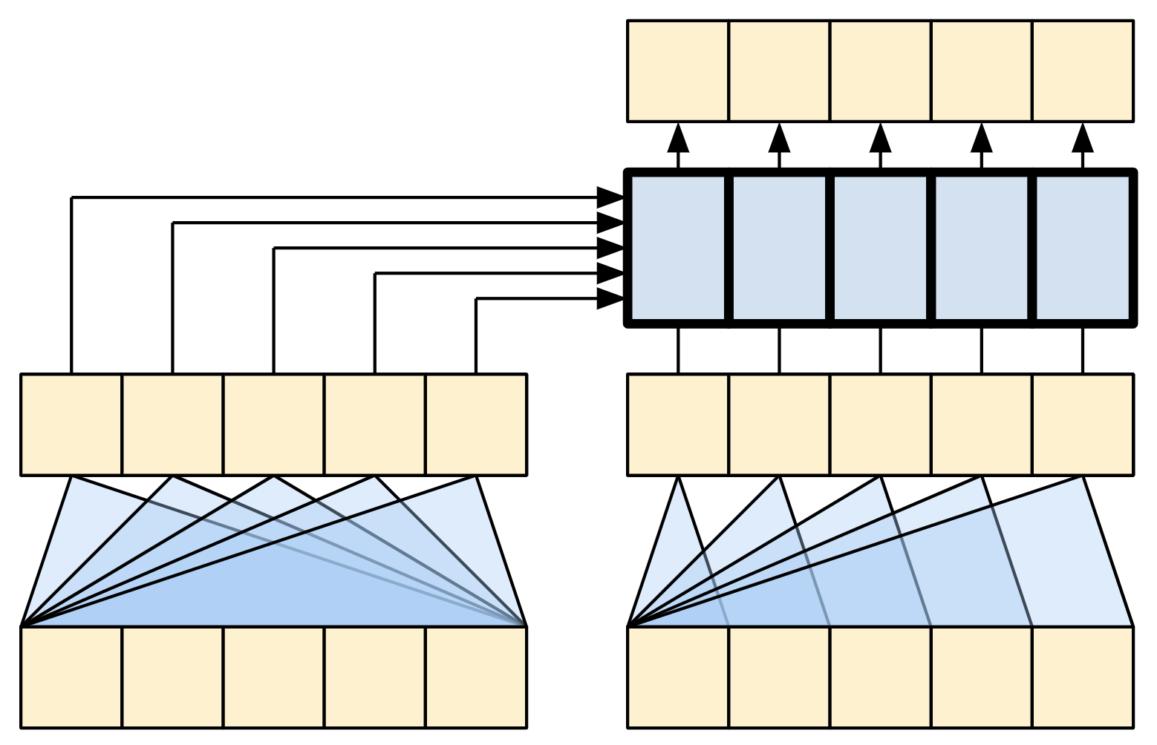
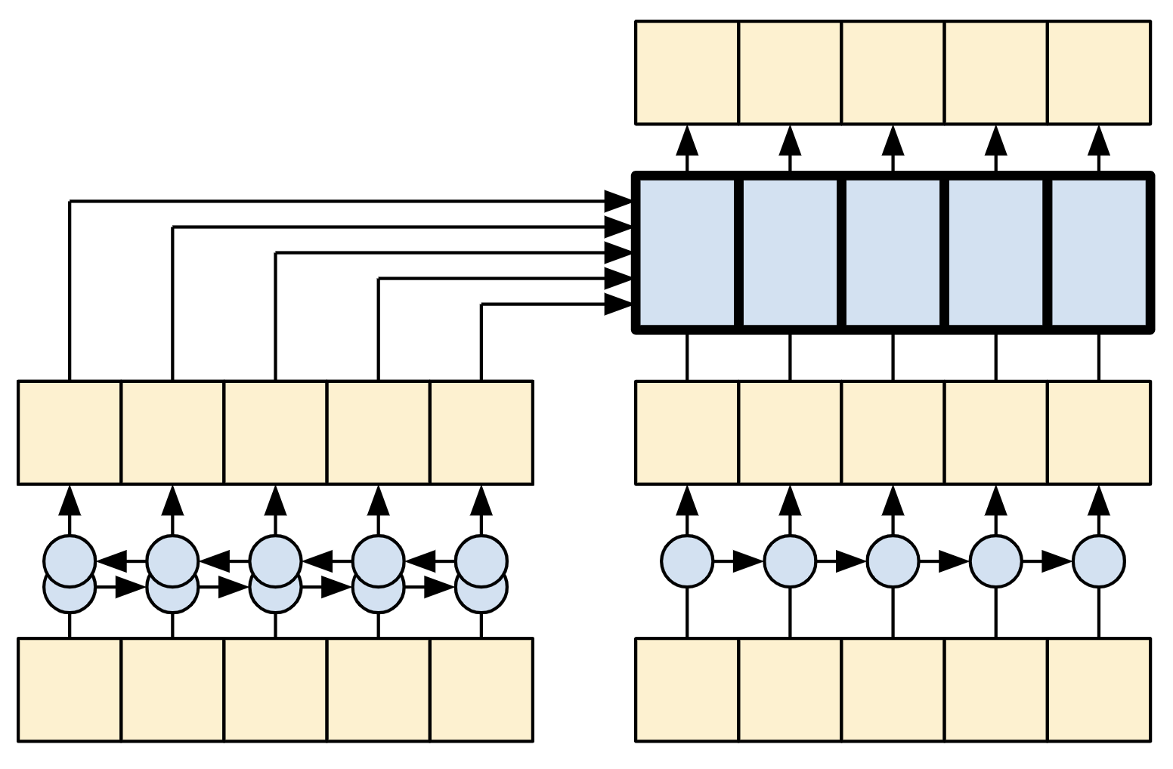
PNP
PASSSION & PIONEER
Transformer
Transformer
4-layer transformer
1-layer transformer
RNN + Attention model
https://lena-voita.github.io/nlp_course/seq2seq_and_attention.html

Slide 33

PNP
PASSSION & PIONEER
Transformer
Transformer
https://jalammar.github.io/illustrated-transformer/

Slide 34

PNP
PASSSION & PIONEER
Transformer
Transformer
https://jalammar.github.io/illustrated-transformer/

Slide 35
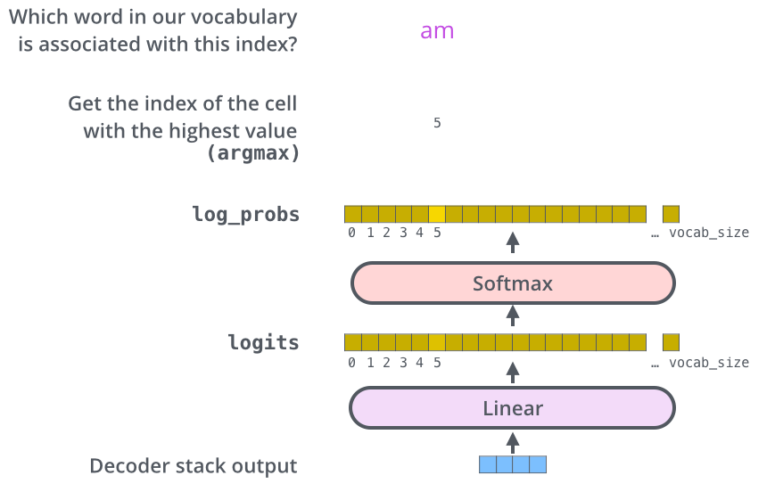
PNP
PASSSION & PIONEER
Transformer
Transformer
https://jalammar.github.io/illustrated-transformer/

Slide 36
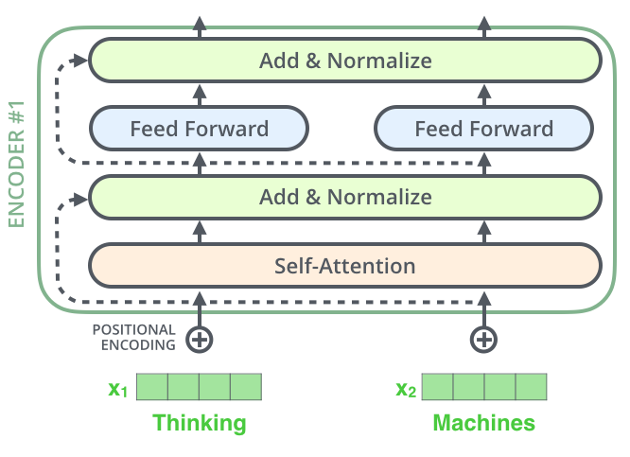
PNP
PASSSION & PIONEER
Transformer
Transformer - Residual connections (잔차 연결)
https://lena-voita.github.io/nlp_course/seq2seq_and_attention.html

Slide 37

PNP
PASSSION & PIONEER
Transformer
Transformer - Residual connections (잔차 연결)
https://lena-voita.github.io/nlp_course/seq2seq_and_attention.html

Slide 38

PNP
PASSSION & PIONEER
Transformer
Transformer - Residual connections (잔차 연결)
https://lena-voita.github.io/nlp_course/seq2seq_and_attention.html

Slide 39
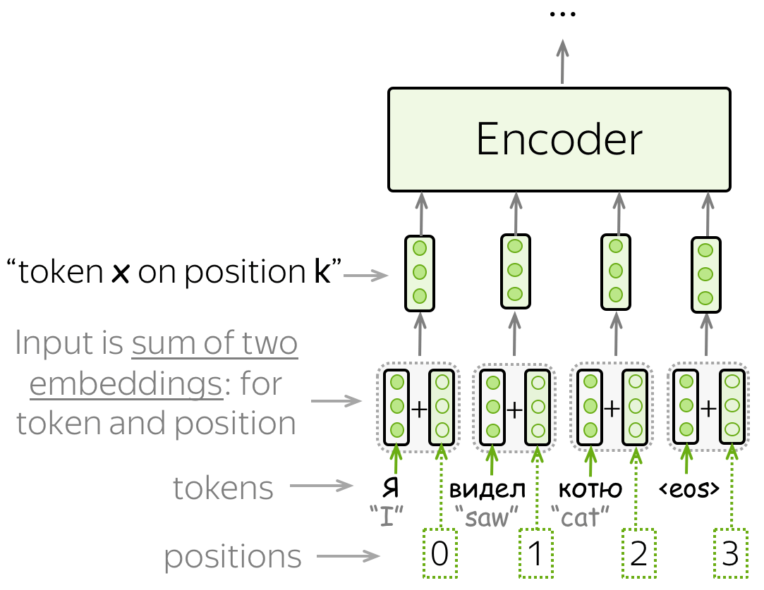
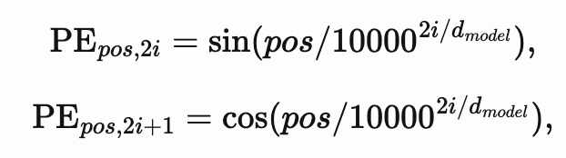

PNP
PASSSION & PIONEER
Transformer
Transformer – Positional Encoding (순서정보 추가)
단어의 순서를 설명하기 위해서 PE를 사용합니다.
https://lena-voita.github.io/nlp_course/seq2seq_and_attention.html

Slide 40
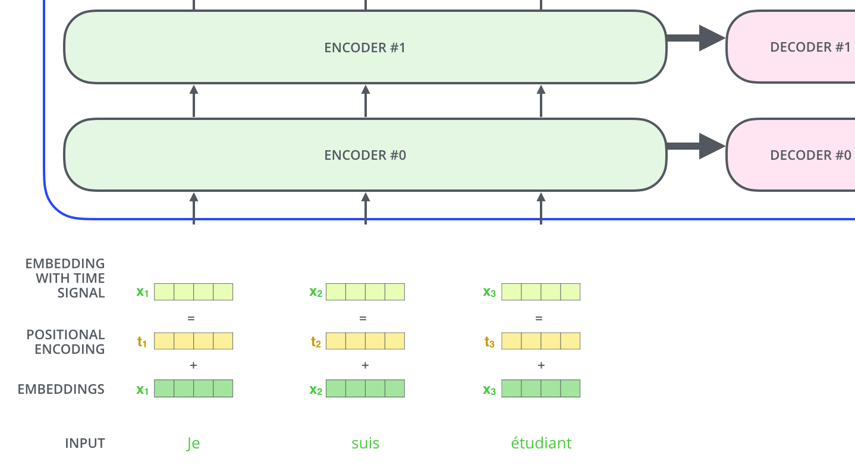
PNP
PASSSION & PIONEER
Transformer
Transformer – Positional Encoding (순서정보 추가)
https://jalammar.github.io/illustrated-transformer/

Slide 41
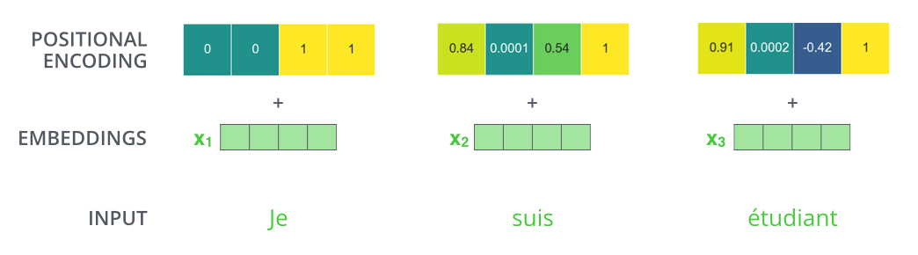
PNP
PASSSION & PIONEER
Transformer
Transformer – Positional Encoding (순서정보 추가)
https://jalammar.github.io/illustrated-transformer/

Slide 42
PNP
Q & A ?

